Slide 1
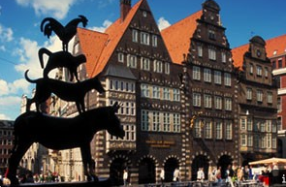
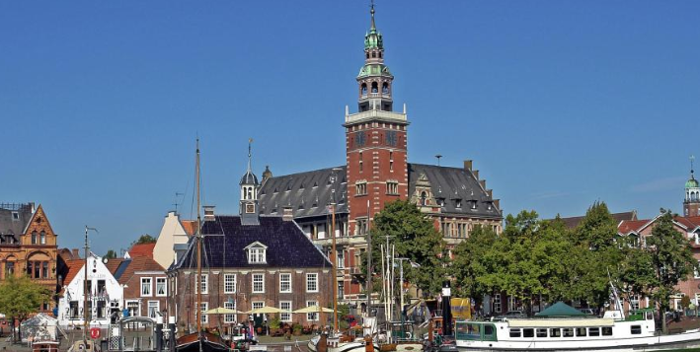
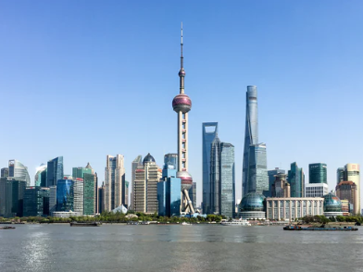
Bremen
Leer
Shanghai
Liberty One (Asia) Co., Ltd.
联舶威船舶管理有限公司

Slide 2
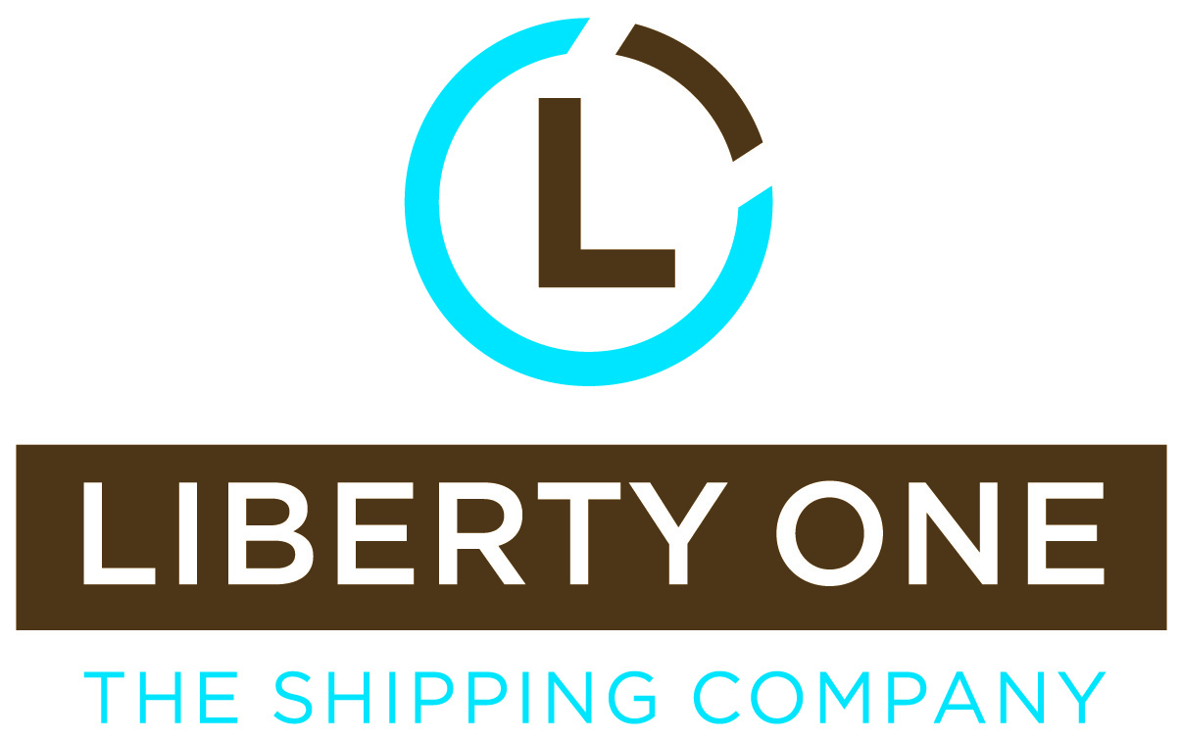

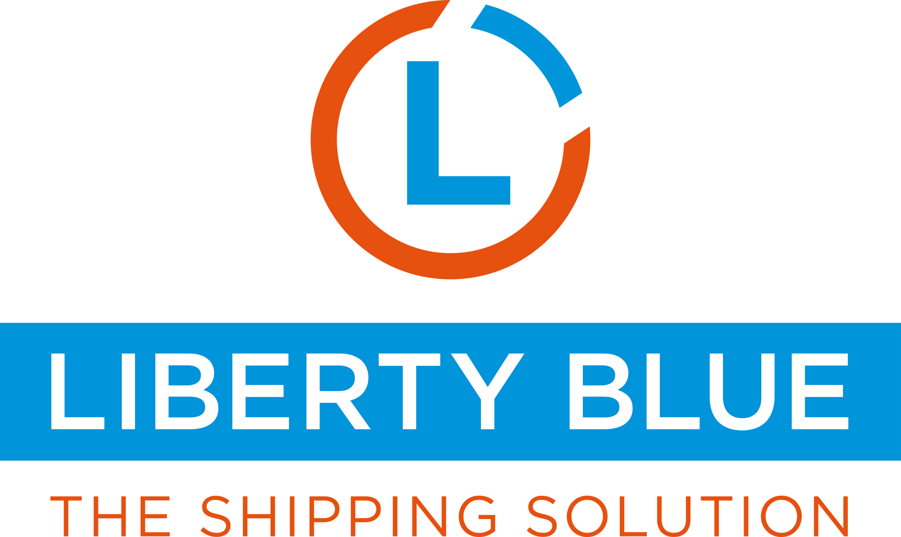
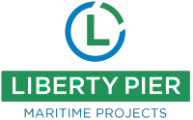

LOA NEW BUT STRONG AND PROFESSIONAL
- trustworthy and flexible -
Liberty One Asia is a joint venture maritime service provider between Liberty Group in Leer and Maritime Risk Manage Group in Hongkong, to service banks and investors in China.
Service profile: Financing, Restructuring, Insolvencies, Loan Portfolios, Inspections, technical Supervision, Newbuilding, Insurance, Software
Core competencies: all-encompassing maritime and financial know-how, consultancy service to banks and investors
Managed maritime assets since 2019 establishment: > USD 100 mill.
Managed ships since establishment: > 10 (Bulkers, Multi-Purpose, Container Vessels)
Liberty One (Asia) Co., Ltd.
联舶威船舶管理有限公司
A team of maritime service providers to banks, investors, ship owners and managers

Slide 3
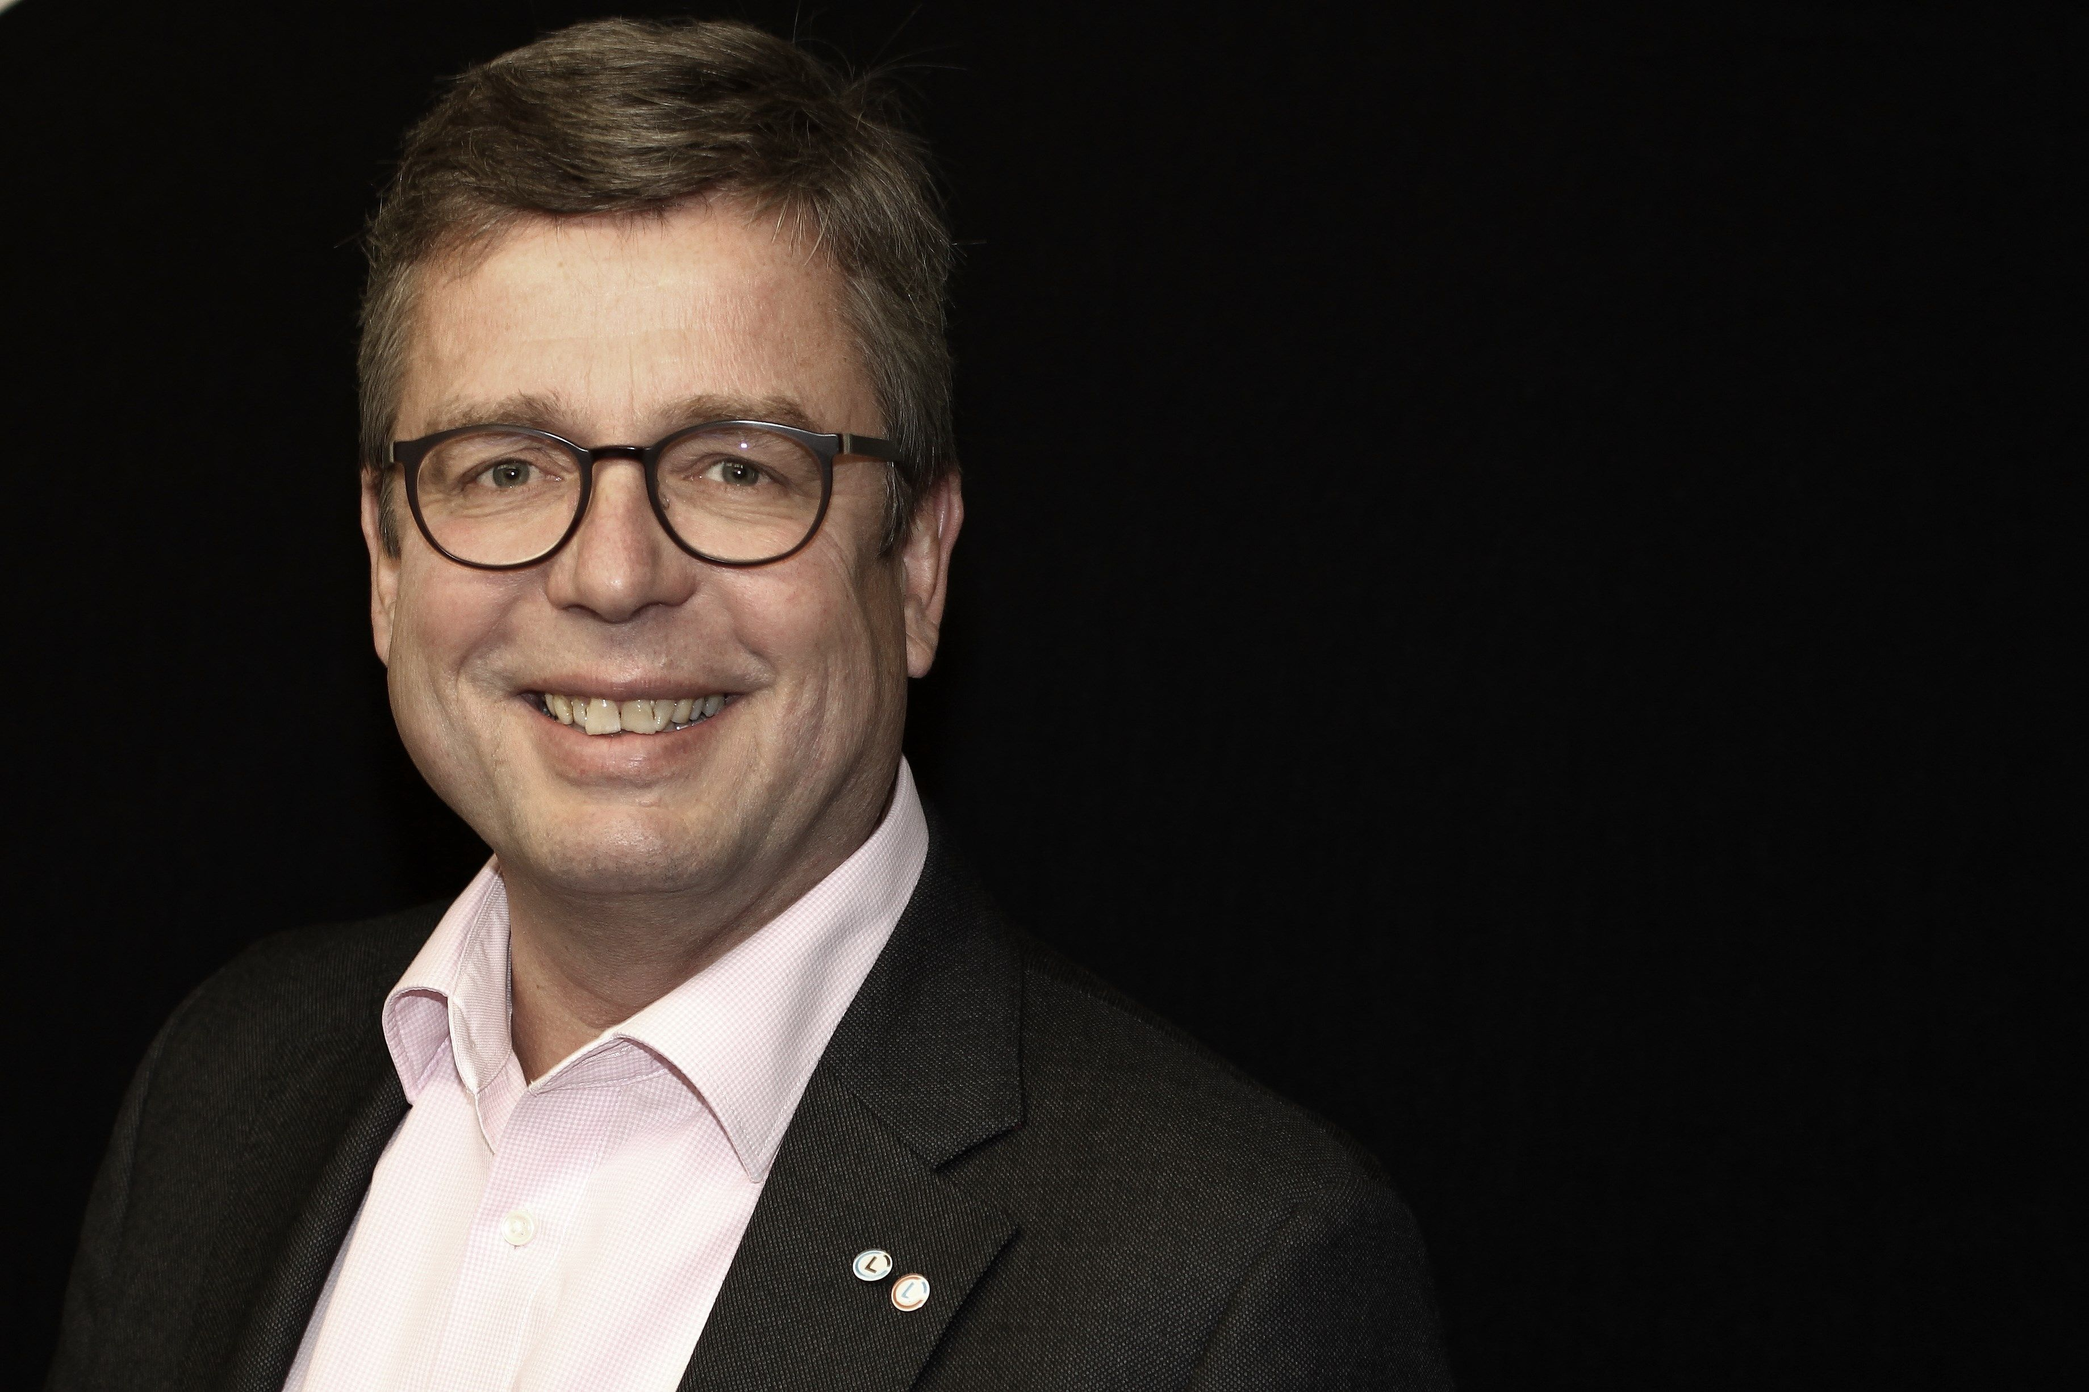

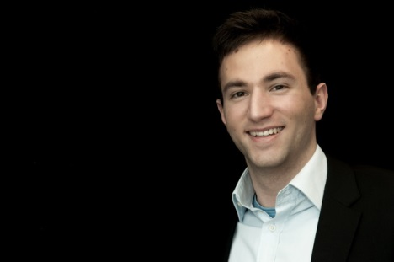

Liberty Group Executives
- trustworthy and flexible -
Dietrich Schulz
(Sole shareholder/Director)
Susanne Meyer
(Director Liberty One / HR)
Ole Bendlin
(Director Handelshaus)
Wenko Schmidt
(Director Liberty Blue)
Marine Merchant
1963, +35 years of international shipping experience
Since +25 years in management positions
Ex Deutsche Afrika Linien (DAL), Columbia, Hartmann Reederei
Lawyer, Human Resources
1959, +30 years of international shipping experience
Since +20 years in management positions
Ex Columbia, Dr. Peters / DS Schiffahrt
BA Shipping & Chartering
1988, +10 years of international shipping experience
3 years in management positions
Ex Maersk Broker
Master Mariner / Marine Merchant
1981, +15 years of international shipping experience
2 years in management positions
Ex Hartmann Reederei, Nimmrich & Prahm
A team of maritime service providers to banks, investors, ship owners and managers

Slide 4
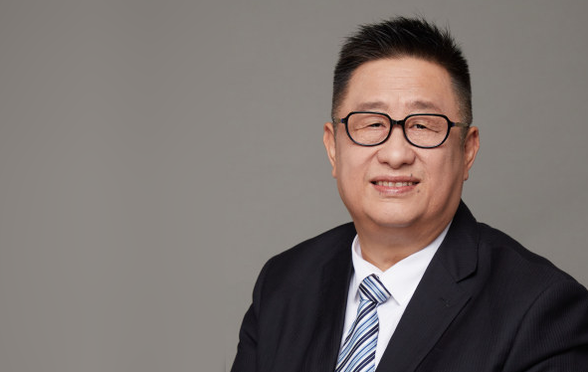
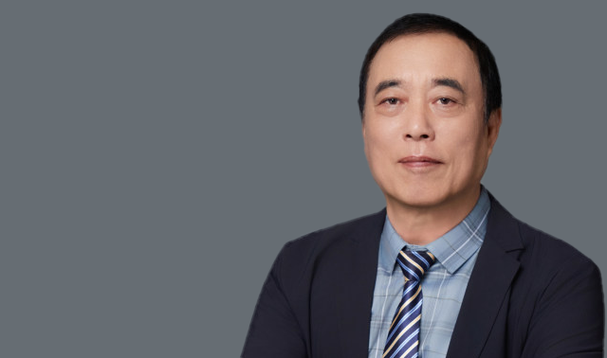
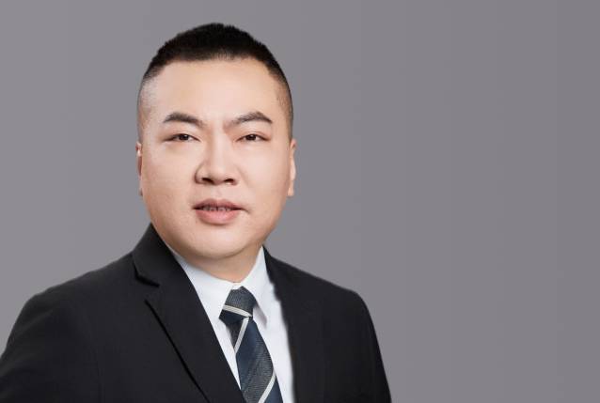
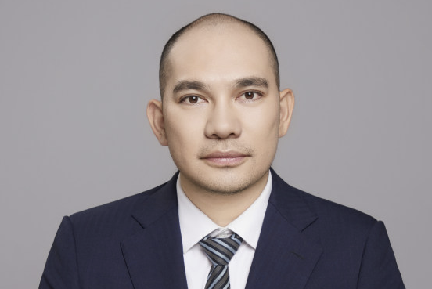
Liberty One Asia Fleet Technical Management Team
…taking care of your vessel assets 24hrs 7 days!
CE ZHU Gongxiang
(General Manager)
Captain XUE Bing
(Marine Manager)
CE Yang Jian
(Procurement Manger)
CE Ni Xiaohu
(Purchasing Manger)
8 years as Chief Engineer serving onboard
7 years experience of Technical Management as Senior Chief Engineer
7 years experience as Fleet Manager / Technical Managing Director / Marine Technical Superintendent
5 years as Vice General Manager in China Shipping
10 years of international shipping experience as Captain of vessel
7 years experience of Safety Supervision Department.
4 years experience as marine manager.
10 years as fleet manager in COSCO
Marine Engineer
12 years of international shipping experience
supervisor of Newbuilding
Comprehension of PSC, FSC and class regulation & legislation
Purchasing Supervisor 2 years experience in Marine spare parts purchasing
Four years engineering ship engine room as Fourth Engineer
A team of maritime service providers to banks, investors, ship owners and managers

Slide 5


Liberty Group at a glance (One Stop Shopping)
Liberty One is a maritime service provider to banks and investors (Bremen, Hamburg and Shanghai)
Service profile: Financing, Restructuring, Insolvencies, Loan Portfolios, Inspections, technical Supervision, Newbuilding, Insurance, Software
Core competencies: all-encompassing maritime and financial know-how, consultancy service to banks and investors
Liberty Pier is a commercial manager and industry representative (Bremen and Leer)
Service profile: Ship Sale & Purchase, Market Analysis, Valuations, Charter Parties, Contracts of Affreightment, Recycling, Auctions, Ship Repair, Rudder Systems, Security Personnel
Core competencies: exclusive access to distressed-assets, (off-market) transactions, tailor-made (value improving) solutions
Proven global network
Cooperations with Ship Owners, Banks, Financial Institutions, Administrators, Brokers, Shippers, Agents, Lawyers, Authorities, Shipyards, Manufacturers, Service Providers
Managed maritime assets since establishment: > EUR 600 mill.
Managed ships since establishment: > 100 (Bulkers, Multi-Purpose, Container Vessels, Tankers)
Well reputed partner of banks: cooperation with >10 German and multi-national banking entities
Liberty Blue is a third-party shipmanagement company also for owned tonnage
Liberty Blue unifies highly reputated shipmanagers and ships to accelerate much needed consolidation within the industry
Core competencies: transparent fee structure, professional (real-time) reporting, crewing, maritime software-solutions
Capital Liberty Invest (C L I) a joint venture between Evangelos Marinakis & Dietrich Schulz, established in 2018 in order to join equity forces to invest in different shipping segments and sizes in the German and global shipping market.
C L I seeks growth opportunities in the container segment, ranging from feeder to Post-Panamax vessels, as well as in the crude and product tanker, dry bulk and multi-purposes segments
Cash buyers with prompt performing power
2 x 1.800 TEU 2nd hand feeder container vessels developed in 2019 and managed by Liberty Blue
Fleet of > 20 vessels (Bulkers, MPP & Container). Liberty Blue manages also former fleets of Reederei Buss & Liberty One
Employee profile: Marine Engineers, Master Mariners, Commercial Operators, Accounts & Finance specialists, Safety & Security experts
Currently 30 employees, many with a long history with international “blue chip” shipping companies. Fast decision-making structure
Hanseatic Recruitment (HR) is a human resource agency for shore and sea staff
The company is licensed to recruit professional seafarers for all vessel types as well as shore (medical) staff for employment in Germany

Slide 6
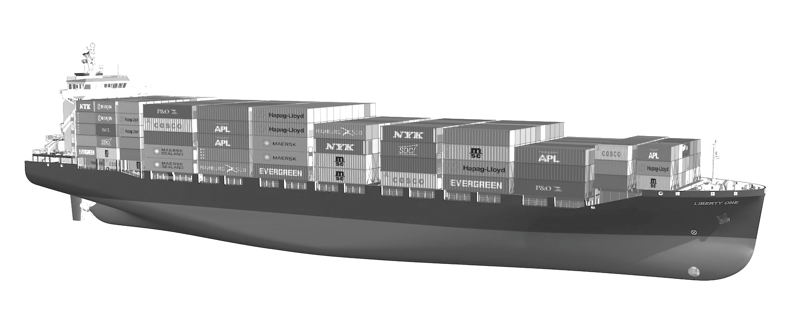
Liberty One Asia - Who We Are
The Liberty One Asia offers a one-stop shopping service portfolio for clients and investors
Vision & Strategy
Founded in 2011 the Liberty Group is a young shipping group setting new standards in the maritime industry. We combine our service mindedness and state of the art solutions with traditional shipping knowledge.
Off-Market Specialist
The Liberty Group is one of Germanys leading "off-market” sale & purchase transaction companies offering exit strategies as well.
Experienced Management
“Grown up” in major market participants, our key personnel combine more than 200 years of shippinexperienceg and financing.
One-Stop Shopping
The Liberty Group covers the entire maritime value-added chain from investment structuring, financial services, transaction consulting, shore and sea ship management to cargo solutions.
Transparency
Our partners and investors have full access to all relevant asset data. A unique software solution enables 24/7 transparent real-time reporting.
Flexibility and Speed
Private ownership and lean management allows prompt closing of deals and flexible investment structures.
Proven Track Record
> 189 successful projects since 2011. Having reference letters from clients.
Free from liabilities
The Liberty Group operates financially independently in the market without inhibiting financial liabilities.
ISO Certified
The Liberty Group companies are ISO 9001 & ISO 14001 certified.
Fleet
Average fleet of +20 ships under management (Container, Bulker, Multi- Purpose Vessels (MPP) & Tanker).
Reliable Contacts and Network
Excellent network in shipping and financial industries enable attractive off- market investments.
Highly competitive pricing
The Group combines performance-based compensation on project work with competitive flat-rate management fees.

Slide 7
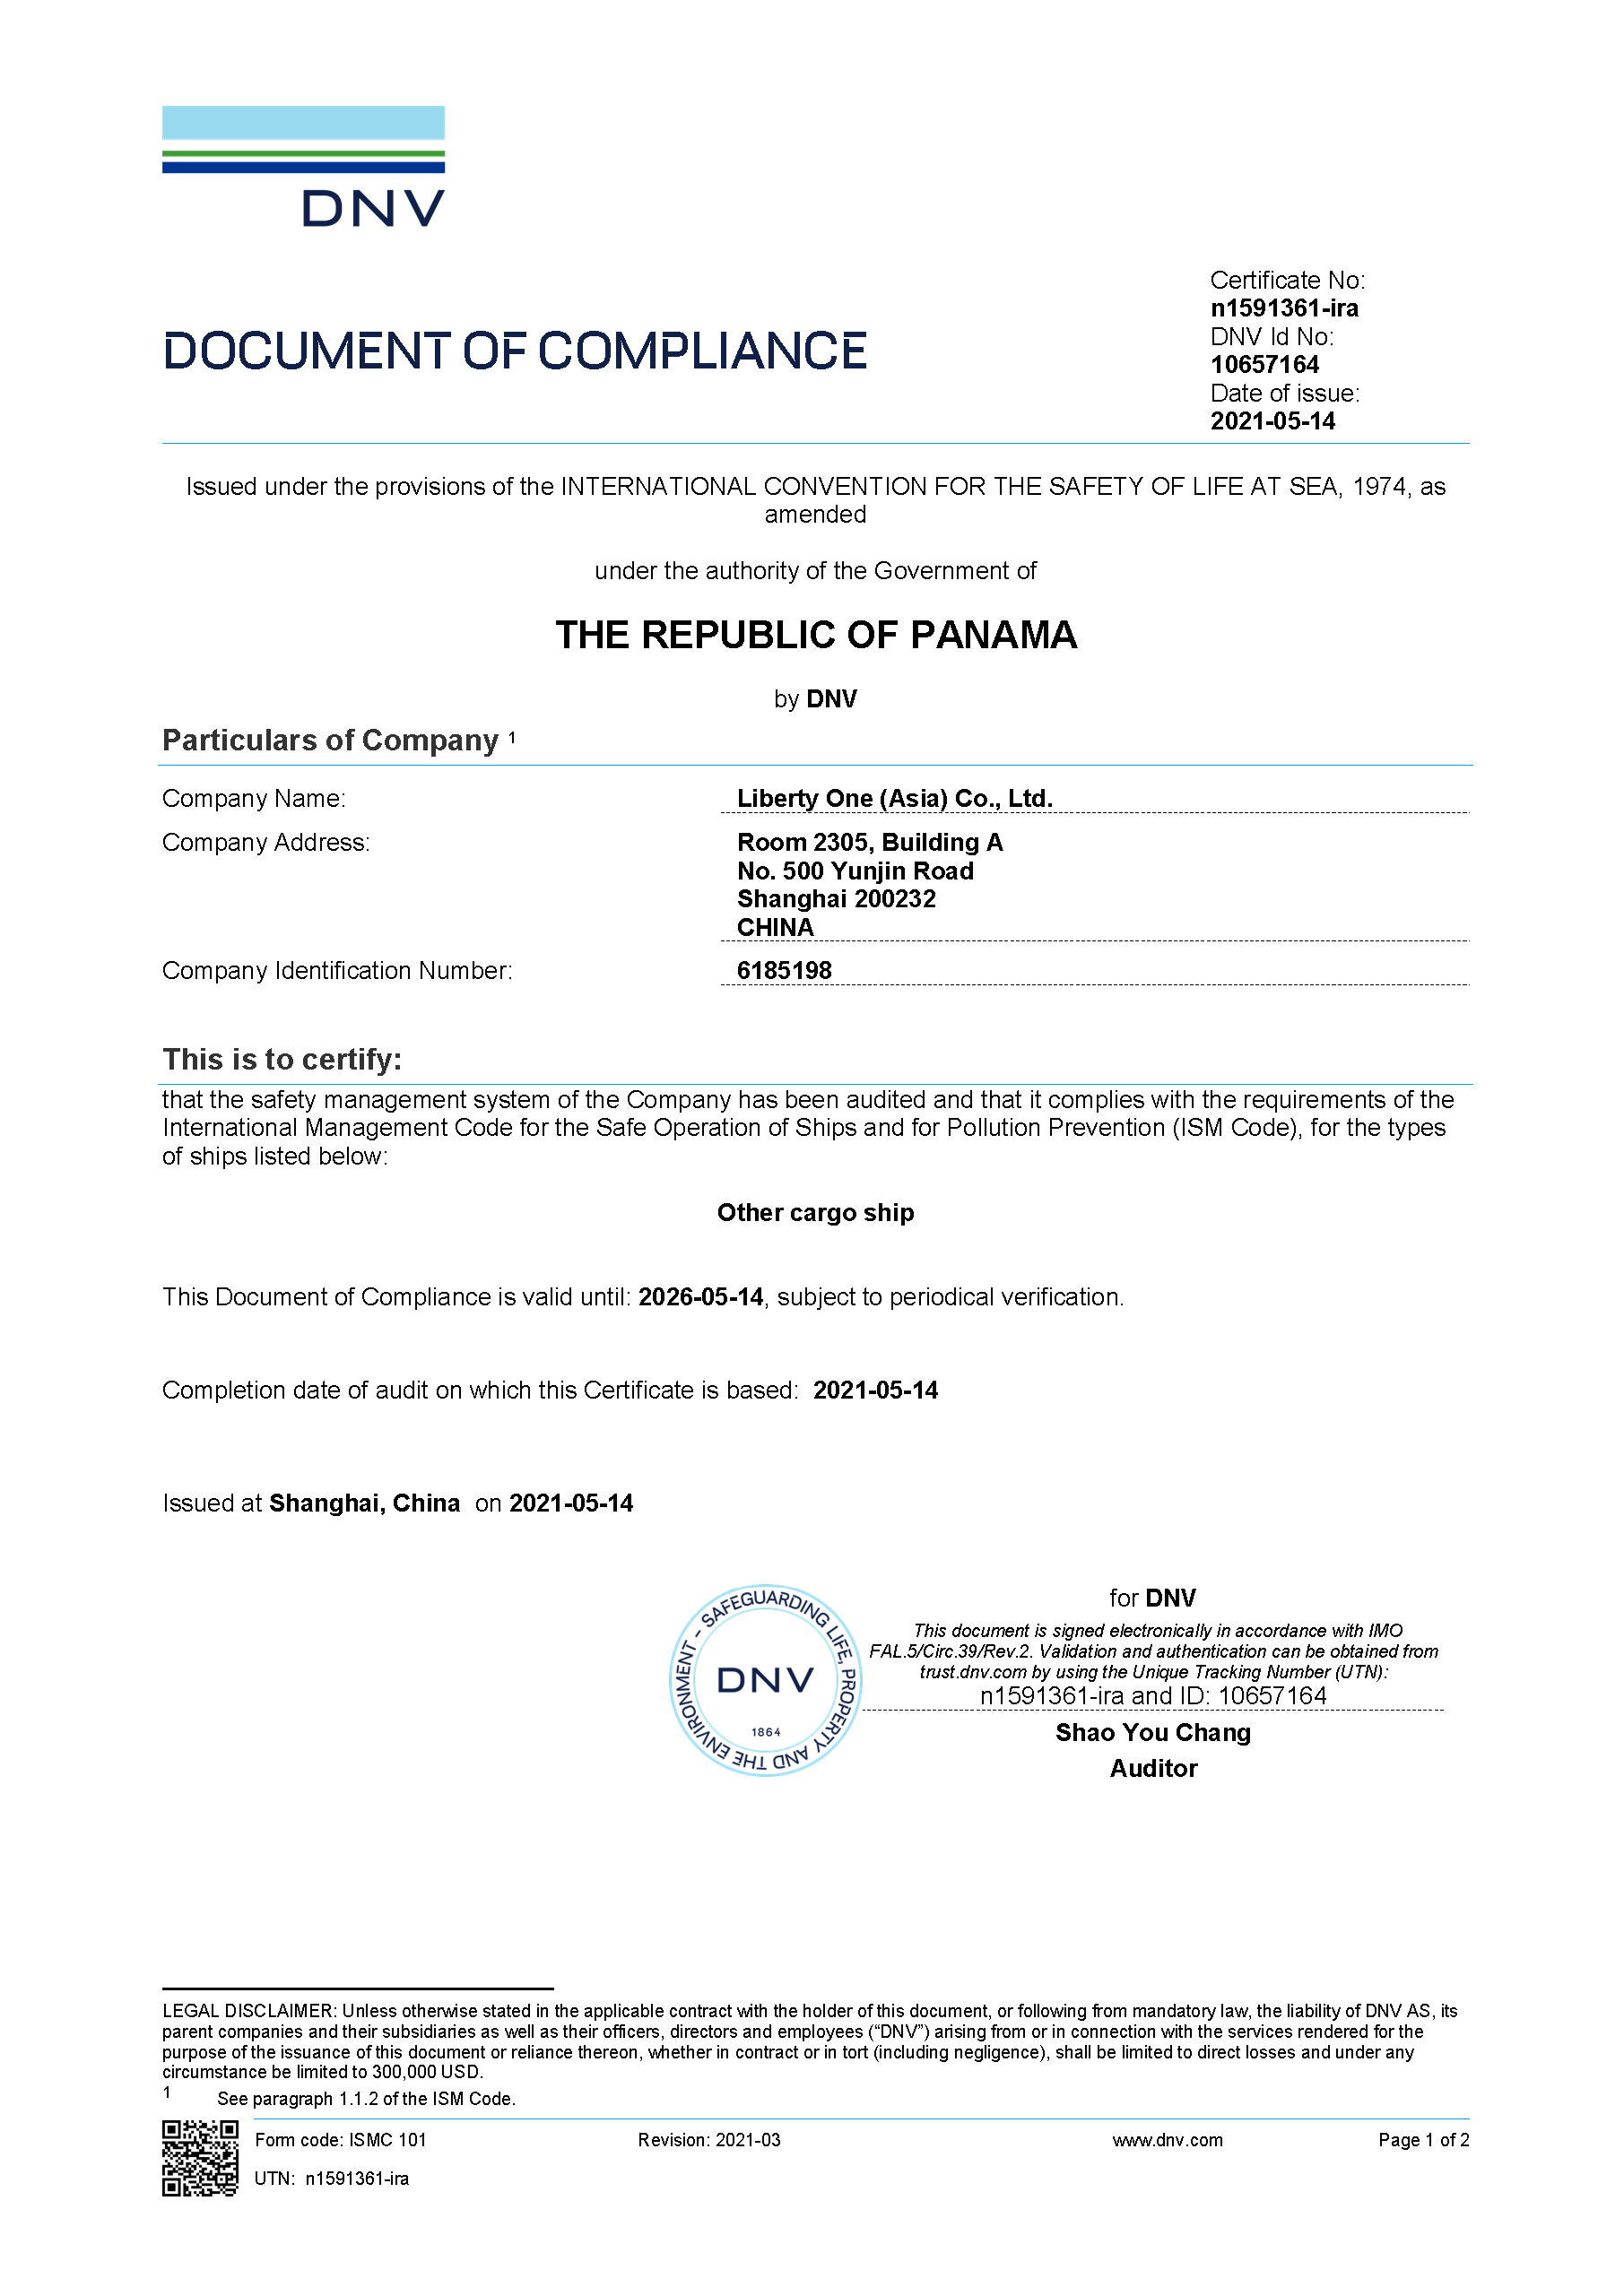
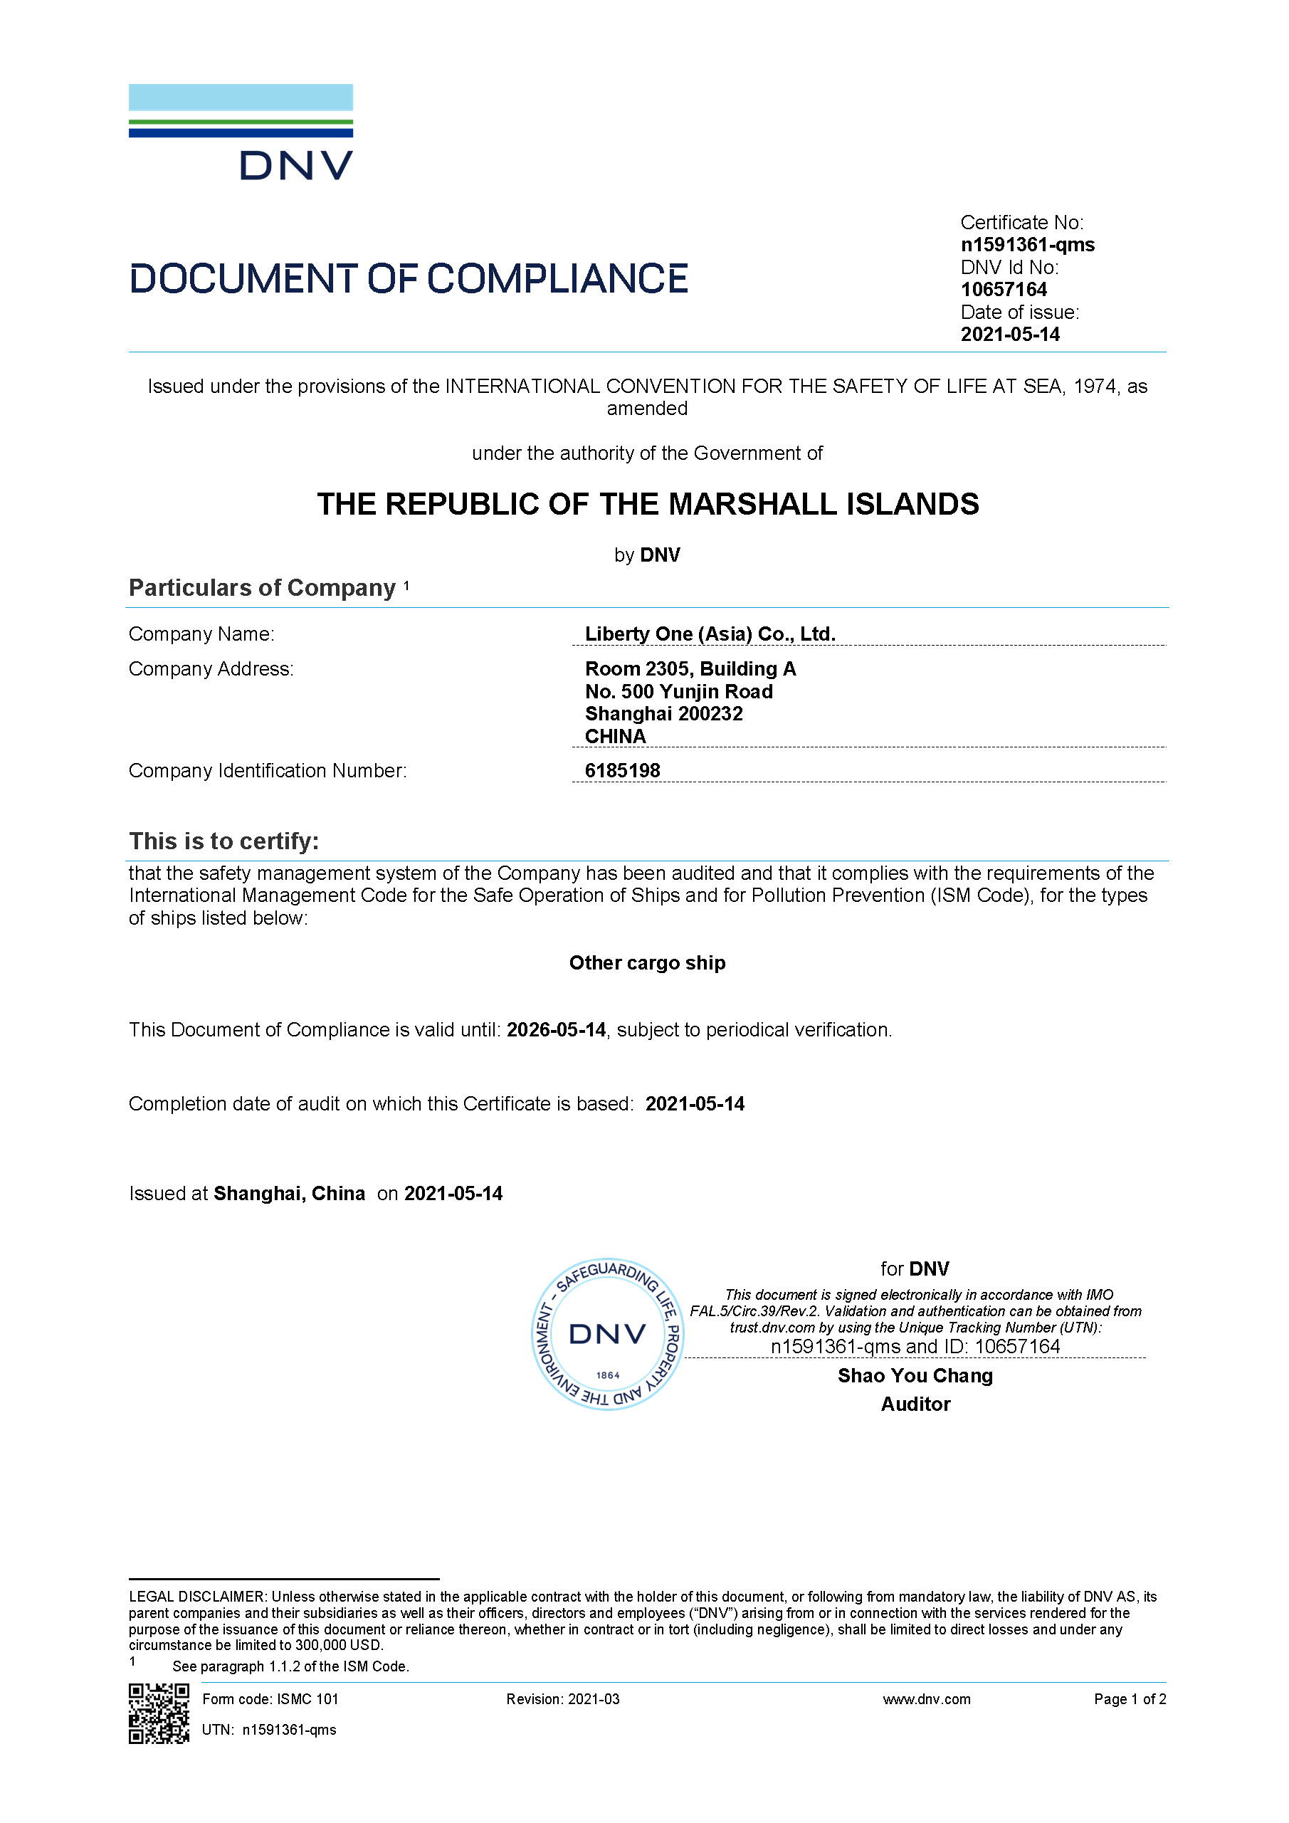
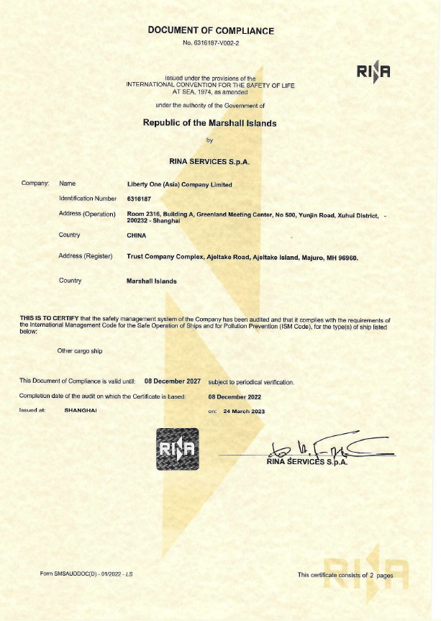
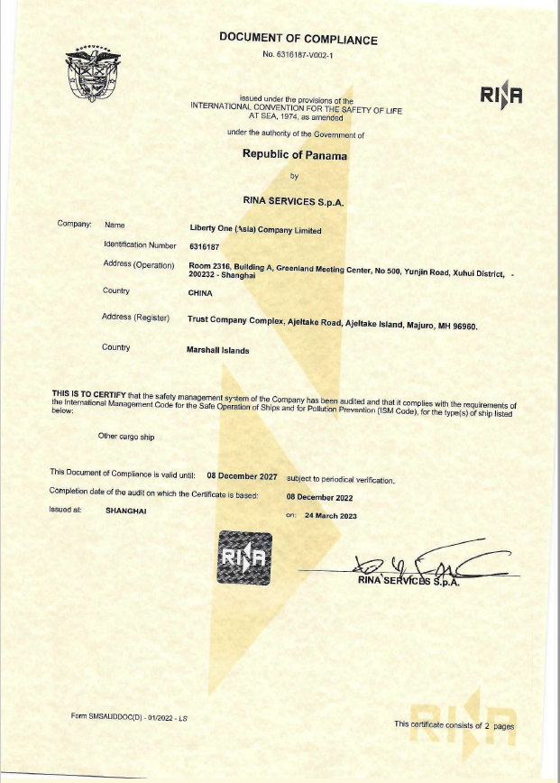
Shipmanagement – Certificates and Licenses
Liberty One (Asia) Co., Ltd. (LOA), holds Document of Compliance for Panama Flag and Marshall Island for Full-Shipmanagement Service issued by DNV

Slide 8



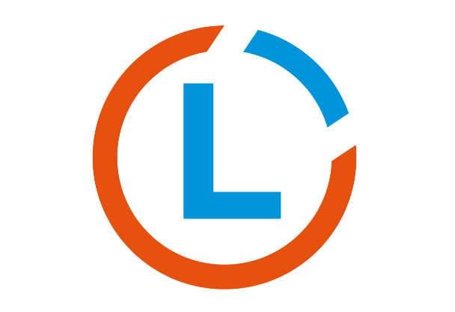
Liberty Group – One-Stop Shopping for Investors
Working together hand in hand – always in the interest to optimize investment returns
INVESTOR
Investor Shopping List:
Market research
Project management
Financing
Sale & purchase
Full ship management
Newbuilding
Recycling
Restructuring
Benchmarking
Consultancy
Transparency
Shopping via
networking
networking
Sale and Purchase (S&P)
Off market specialist
Excellent contacts and network to the maritime industry ensuring an attractive acquisition of assets
Market research
Professional execution of sale and purchase
Second hand transactions
Asset valuation and technical consultancy incl. ship surveys
Chartering brokers for various ships within the Liberty Blue Group
Contract of affreightments
DIGITAL SHIPPING
performed by Liberty Blue
First quality technical and commercial ship-management of MPP-, Container-, Bulker- vessels by Liberty Blue
Combining all needed expertize to maximize investment returns via professional and cost-effective ship management
Reduced running costs as a result of the network, capacities and supplier recourses of its platform members
DSIS & transparent 24/7 on-time reporting
Technical, crewing and commercial evaluation and survey of vessels
Specialist for structuring of ship investments
Tailor-made consulting service for investors combined with market analysis, research and financial expertise for an optimal structured ship investment
Identification and access to appropriate assets via extensive network
Technical an commercial evaluation of vessels
Maritime and financial structuring and solutions
Excellent relationship and access to maritime financial institutes, financing partners & banks
exclusive access to distressed-assets, tailor-made (value improving) solutions, off-market transactions, deep understanding of trends and demand in shipping

Slide 9
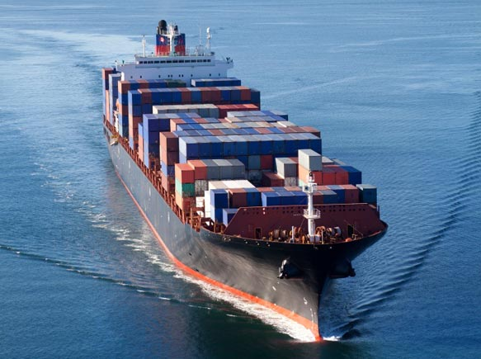
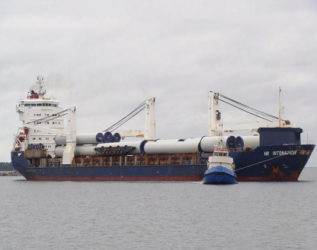
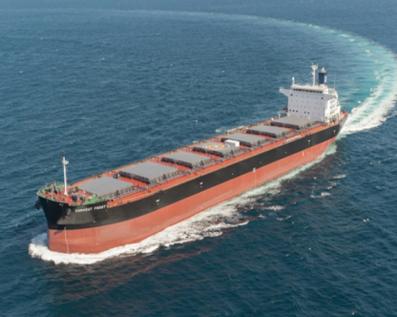
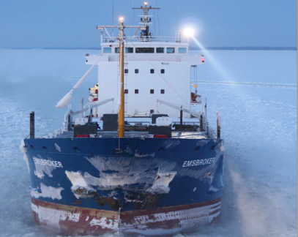

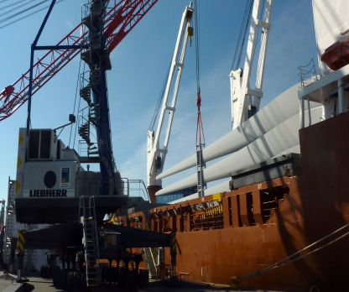

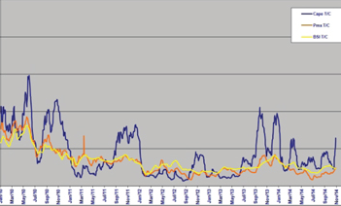
Liberty Group - Track Record History
Liberty Group - Total Shipping Projects
Liberty Group - Ship Management
2013
2017
2020
Handelshaus Track Record
Sold Vessels - 99 units since 2014
Trading Activities
– Container –
– MPP –
– Bulker –
– Gen. Cargo–
Suezmax Tanker
MPP, Bulker
& Tanker
Tankers
& Bulkers
Panamax Bulker
Container Feeder
26
28
7
38
8
18
7
7
500 – 1.200 TEU
Up to 12.800 tdw
Up to 57.000 tdw
1.700 – 9.000 tdw
Debt Deal Consulting
Charter Parties
Auction Sales
Market Analysis

Slide 10
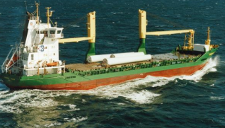
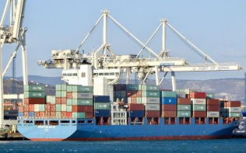
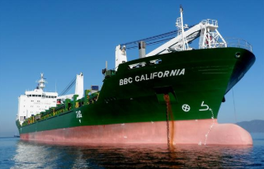
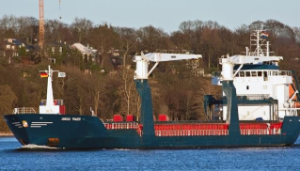
Strong and Specialized in MPP and Container sector
No. | Type | Shipyard | Gear | Flag | Built | Class | Capacity | Managers
1 | F-Type MPP heavy lift | CSC Jiangdong Shipyard, China | 2x150mt | Antigua & Barbuda | 2007 | DNV | 12.744 dwt | Liberty Blue, Leer
2 | F-Type MPP heavy lift | CSC Jiangdong Shipyard, China | 2x150mt | Antigua & Barbuda | 2007 | DNV | 12.744 dwt | Liberty Blue, Leer
3 | F-Type MPP heavy lift | CSC Jiangdong Shipyard, China | 2x150mt | Liberia | 2007 | DNV | 12.744 dwt | Liberty Blue, Leer
4 | F-Type MPP heavy lift | CSC Jiangdong Shipyard, China | 2x150mt | Antigua & Barbuda | 2007 | DNV | 12.744 dwt | Liberty Blue, Leer
5 | MPP | Bodewes Shipyards B.V., Netherland | 2x60mt | Malta | 2004 | DNV | 7.750 dwt | Liberty Blue, Leer
6 | MPP | Peterswerft Wewelsfleth, Germany | 2x60mt | Antigua & Barbuda | 1999 | DNV | 6.265 dwt | Liberty Blue, Leer
7 | Container | Thyssen Nordseewerke GmbH, Germany | 3x45mt | Portugal | 2000 | DNV | 2.472 TEU | Liberty Blue, Leer
8 | Container | Stocznia Szczecinska S.A, Poland | 3x40mt | Liberia | 1998 | DNV | 1.730 TEU | Liberty Blue, Leer
9 | Container | Thyssen Nordseewerke GmbH, Germany | 3x45mt | Liberia | 2000 | DNV | 2.472 TEU | Liberty Blue, Leer
10 | Container | Stocznia Szczecinska S.A, Poland | 3x40mt | Liberia | 1998 | DNV | 1.730 TEU | Liberty Blue, Leer
11 | Container | Sedef Shipyard Istanbul | gls | Marshall Islands | 2008 | ABS | 1.880 TEU | Liberty Blue, Leer
12 | General Cargo | Jiangsu Yangzijiang | 2 x 25 mt | Portugal | 2007 | KR | 8.000 dwt | Liberty Blue, Leer
13 | General Cargo | Jiangsu Yangzijiang | 2 x 25 mt | Portugal / Madeira | 2006 | KR | 8.000 dwt | Liberty Blue, Leer
14 | General Cargo | Volhardingen Shipyard BV | 2 x 40 mt | Portugal / Madeira | 2002 | KR | 8.930 dwt | Liberty Blue, Leer
15 | General Cargo | Volhardingen Shipyard BV | 2 x 40 mt | Portugal / Madeira | 2001 | KR | 8.930 dwt | Liberty Blue, Leer
16 | MPP heavy lift | Wuhu Shipyard | 2x350mt 1x 120mt | Panama | 2014 | DNV | 24.000dwt | Liberty One (Asia), Shanghai
17 | MPP heavy lift | Wuhu Shipyard | 2x350mt 1x 120mt | Panama | 2014 | DNV | 24.000dwt | Liberty One (Asia), Shanghai
18 | Container | Wadan Yards MTW GmbH | gls | Panama | 1999 | CCS | 34.000dwt | Liberty One (Asia), Shanghai
19 | Container | Imabari Shipbuilding | gls | Panama | 1997 | RINA | 24.300dwt | Liberty One (Asia), Shanghai

Slide 11
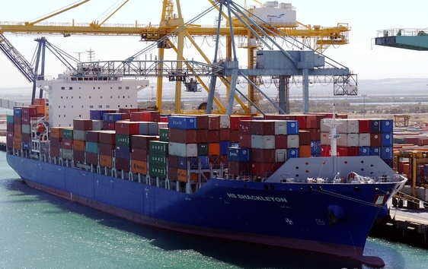
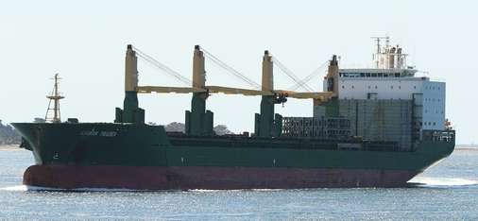
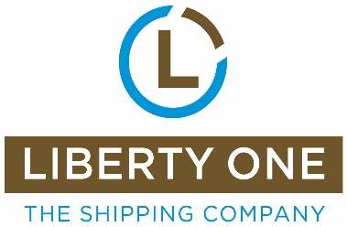
Liberty Group Experience (extract) - Ship & Project Management
always ready to take further vessels into our management on short notice
1.300 TEU –
2.500 TEU
3.500 TEU–
5.000 TEU
5.400 TEU
Bulker up to
92.500 tdw
Tanker
MPP
General Cargo
Active tonnage under full management with Liberty Blue
well experienced staff at Liberty Blue, all being very familiar with feeder tonnage
Full mgmt. done for 4 x Ex –Hansa Treuhand units
2 x 5.000 TEU successfully operated until its sales mid of 2017
Liberty Blue employees well experienced with commercial and technical management of such units
New- buildings being set into service in 2009/2010
58.000 dwt for technically managed for French clients
2 x 73.400 dwt for auction
3 x 92.500 dwt managed in 2014/2015
2 x 56.800 dwt for a German bank in 2015
Project of 3x 6.200 dwt chemical tankers in 2014
Project of one Suezmax tanker in 2015
10 yrs. of technical mgmt. done for 2 x 33.000 tdw with 4 x 60mt lifting capacity
4 x F-Type 12.500 tdw units with max lifting capacity of 360 tons under full mgmt.
Active single deck and tweendeck tonnage between 7.750 tdw and 9.250 tdw under full and/or technical mgmt. with lifting capacities of max. 120tons

Slide 12
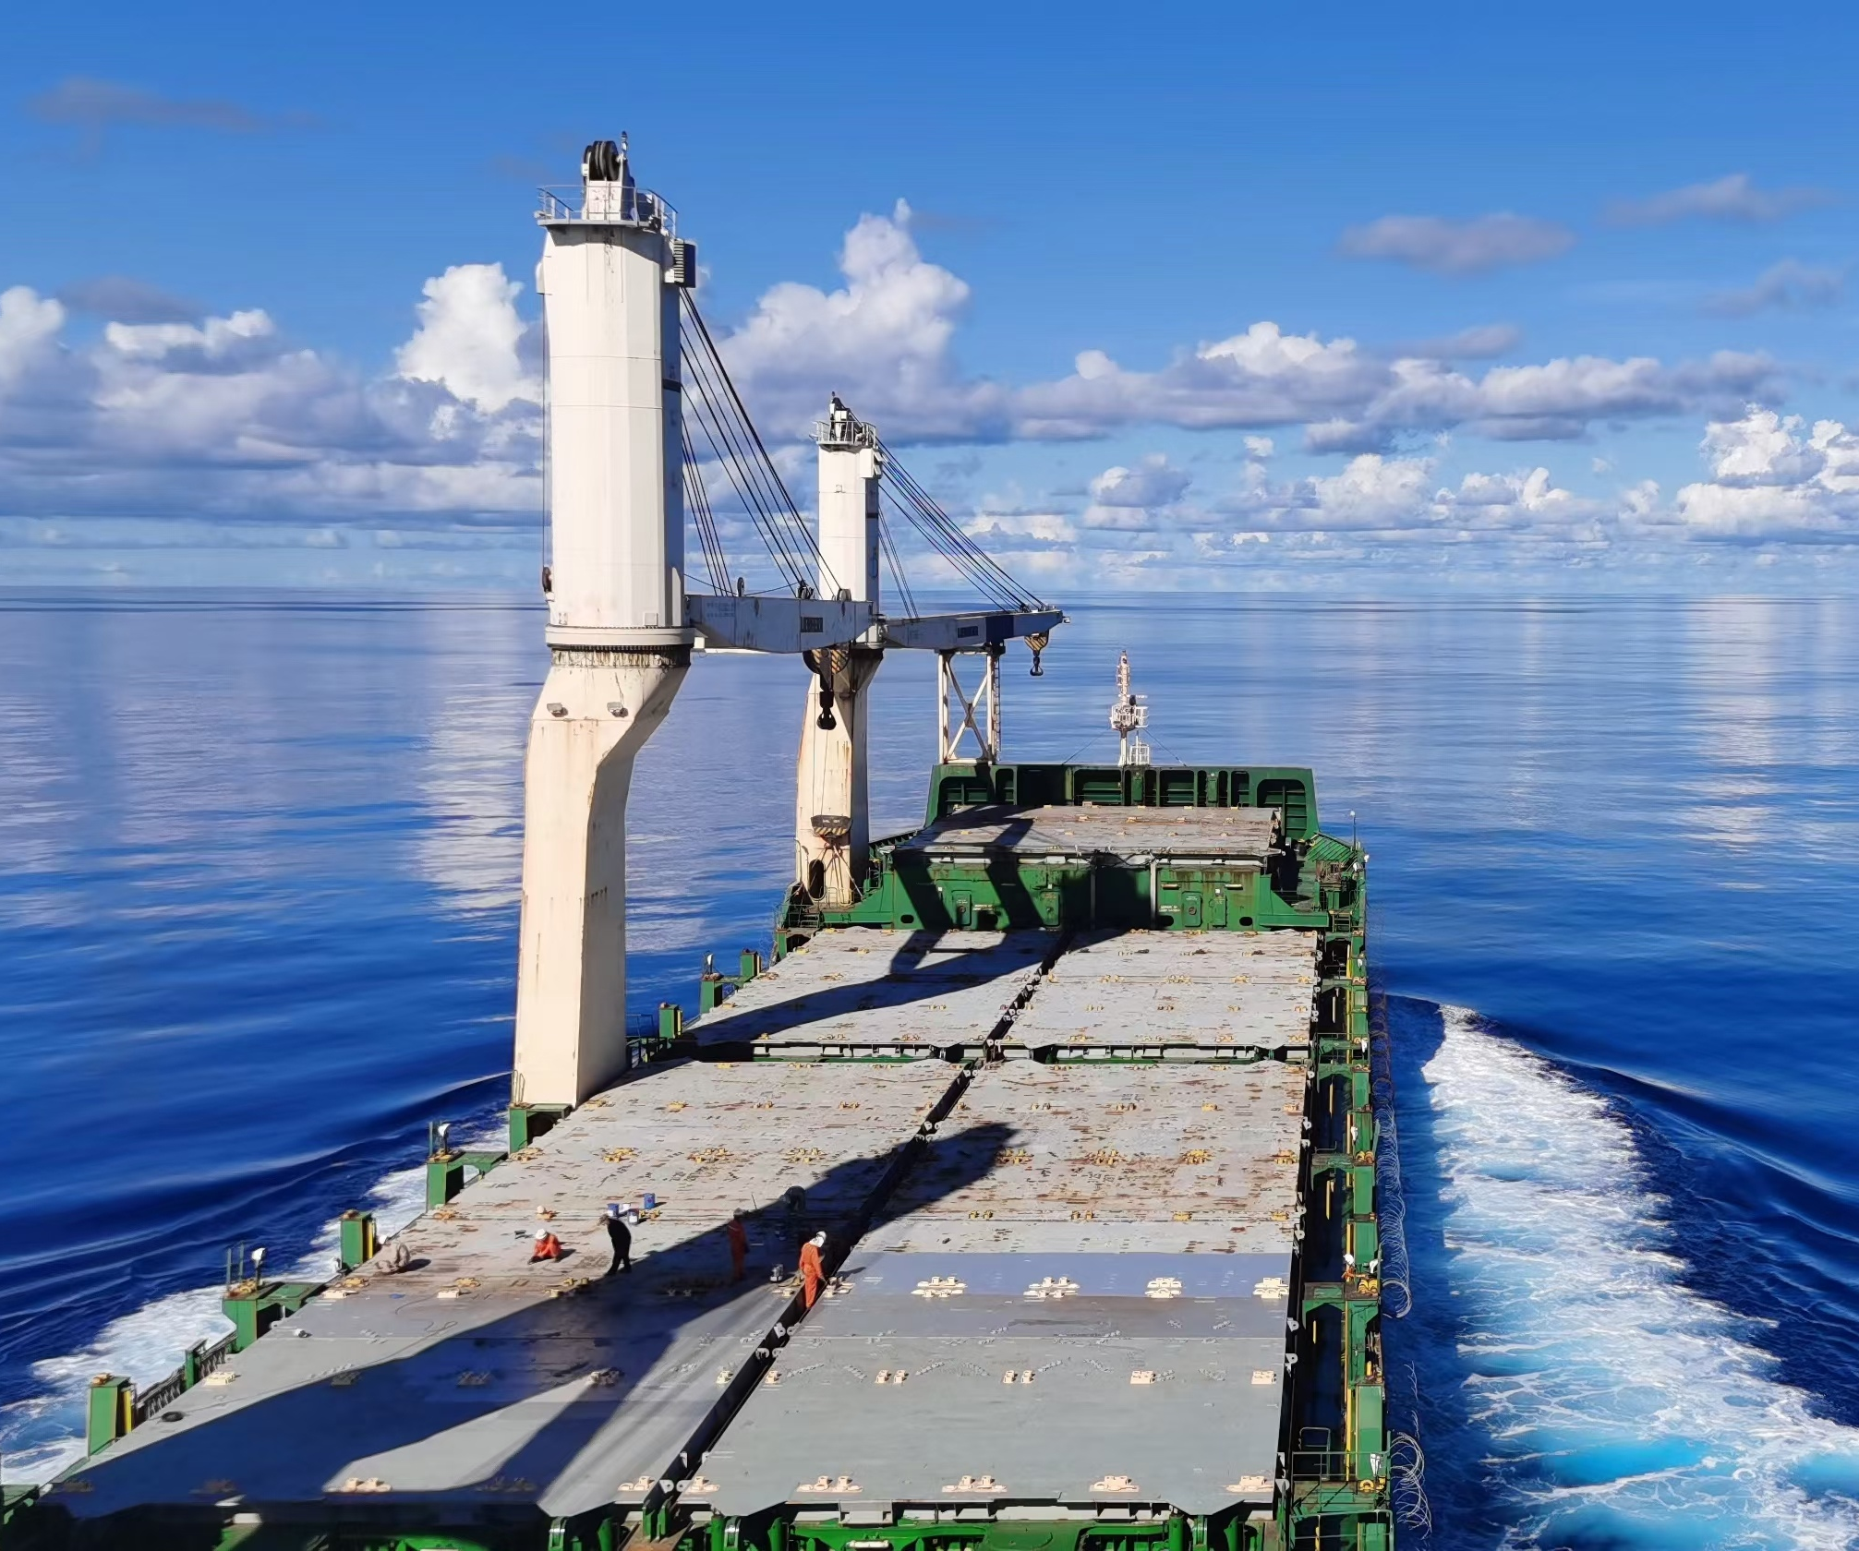
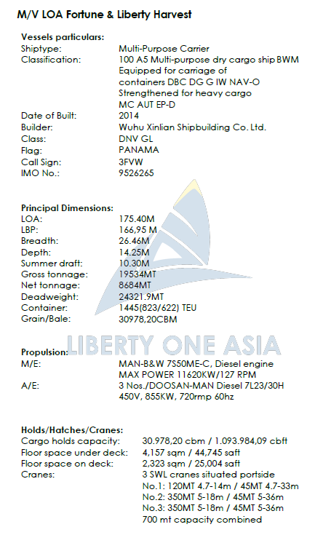
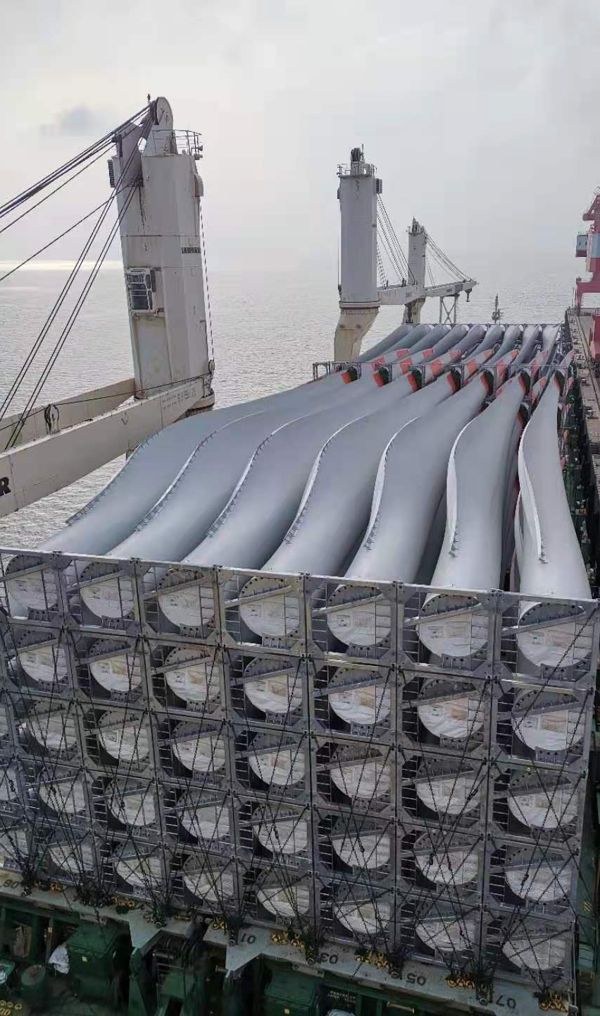
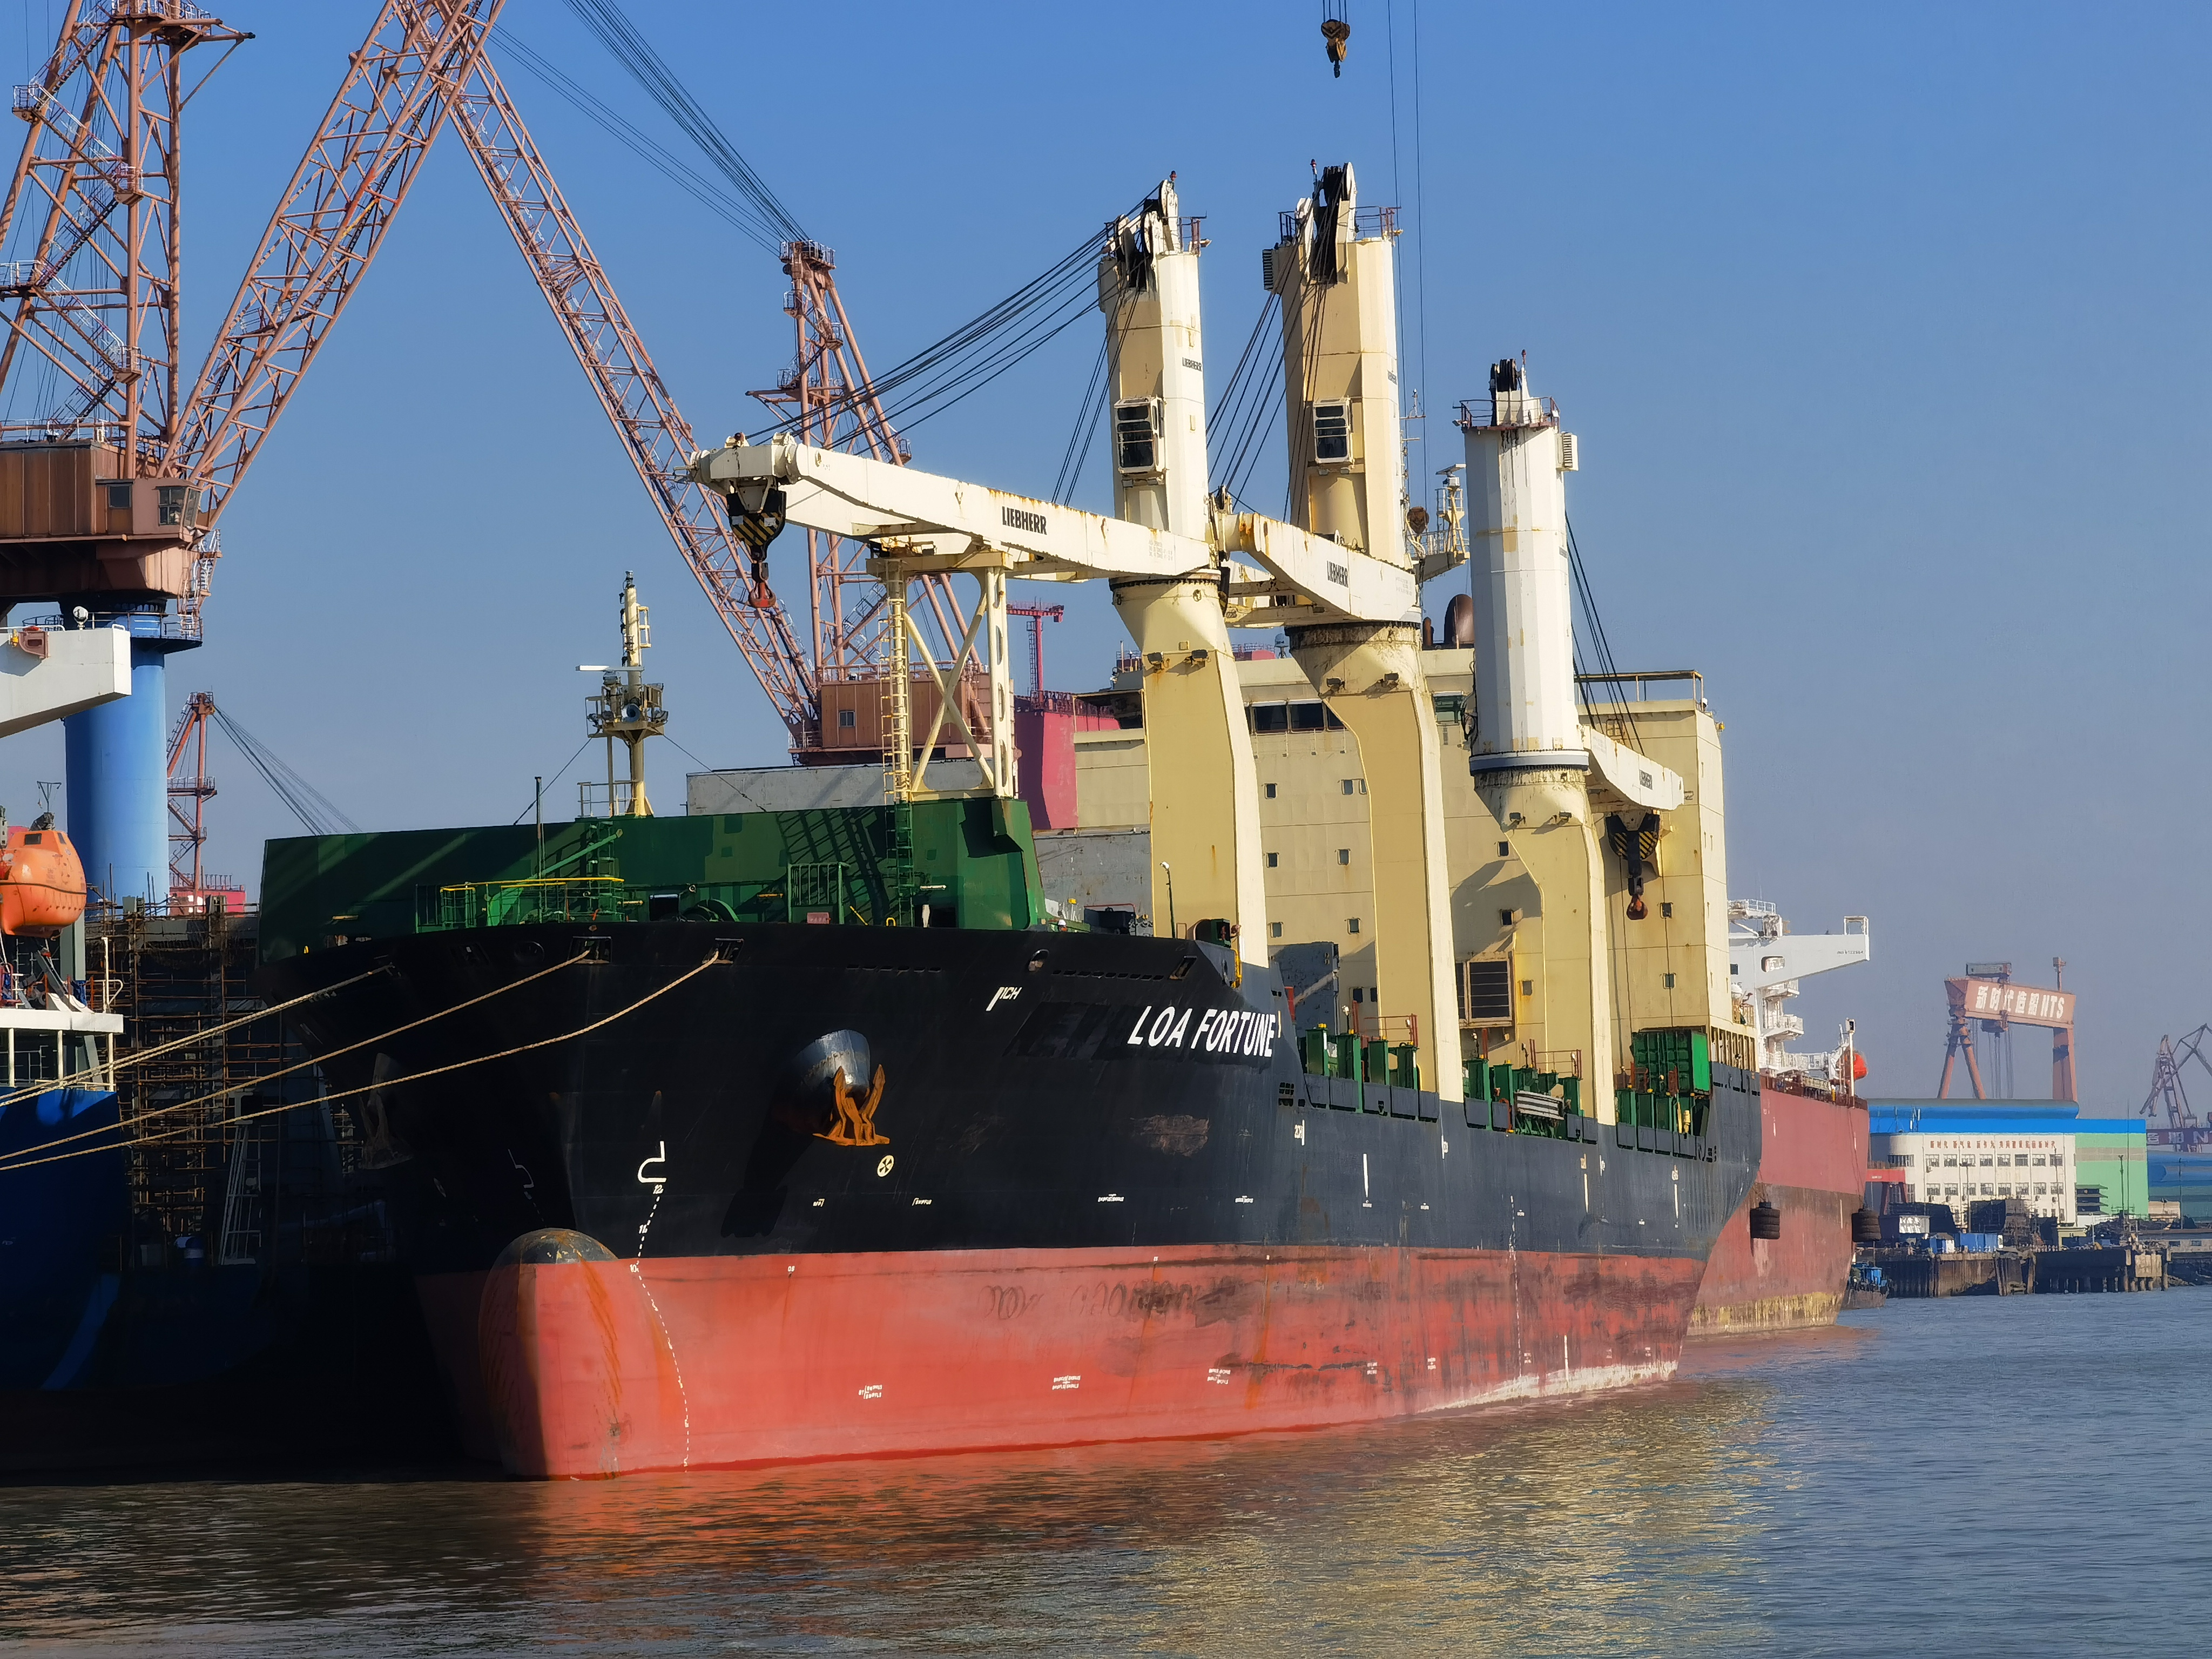
Liberty One Asia Fleet - MPP

Slide 13
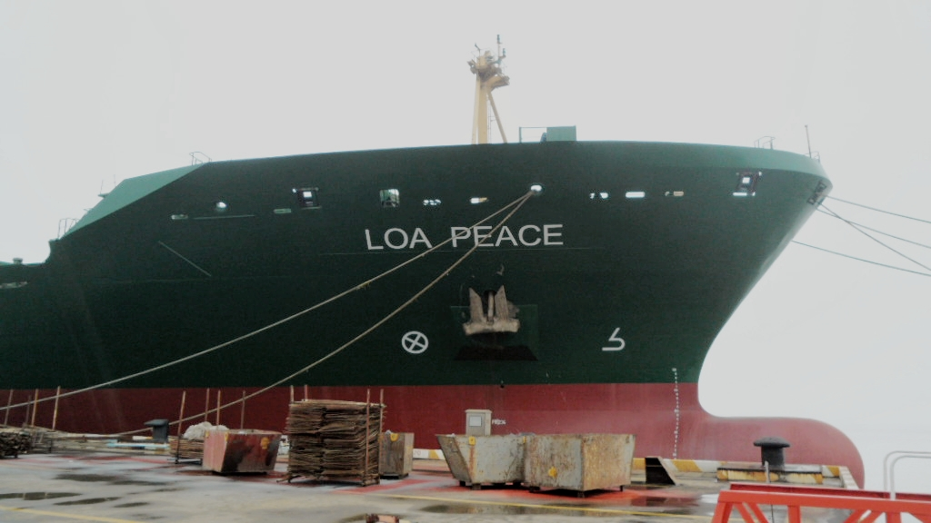
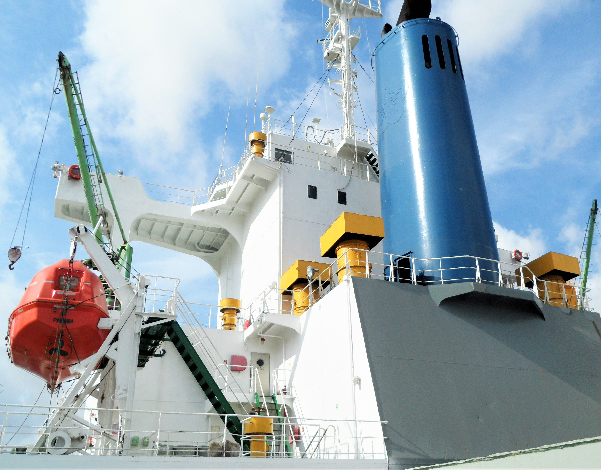
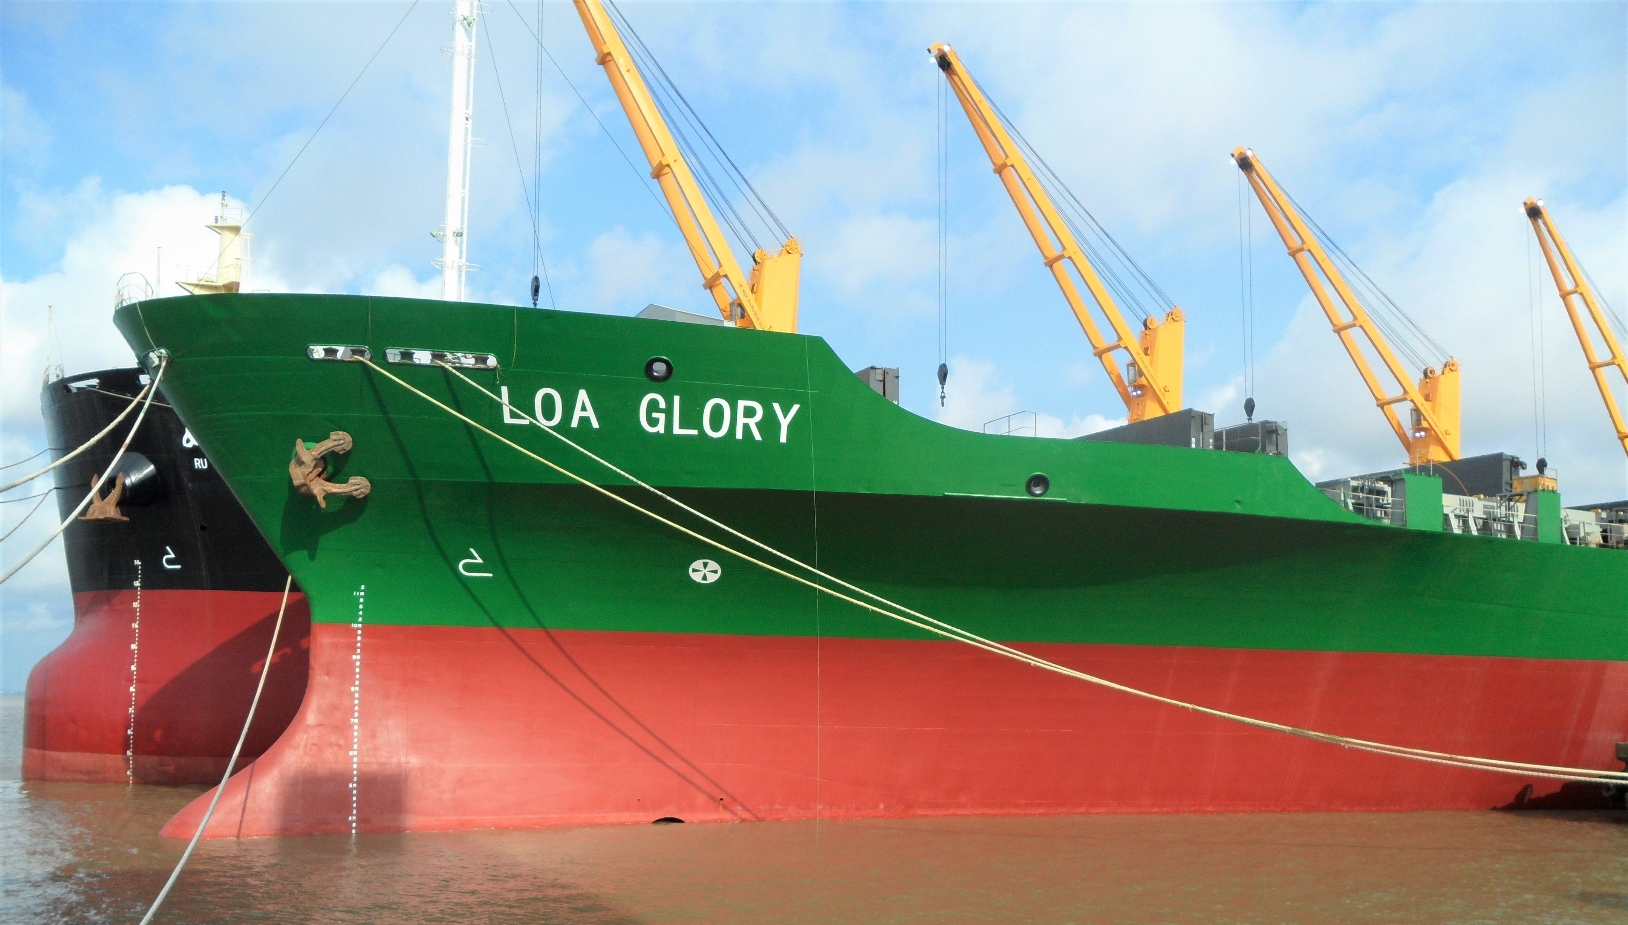
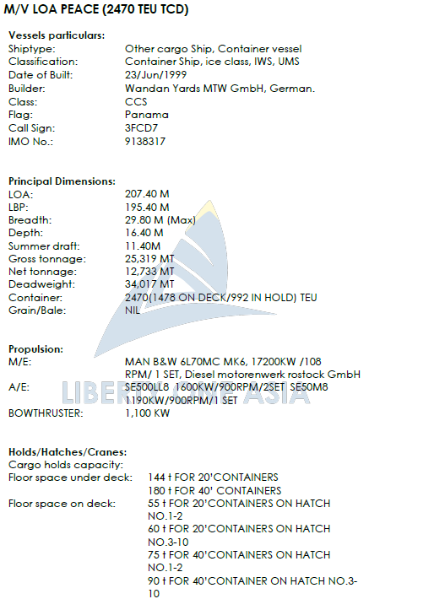
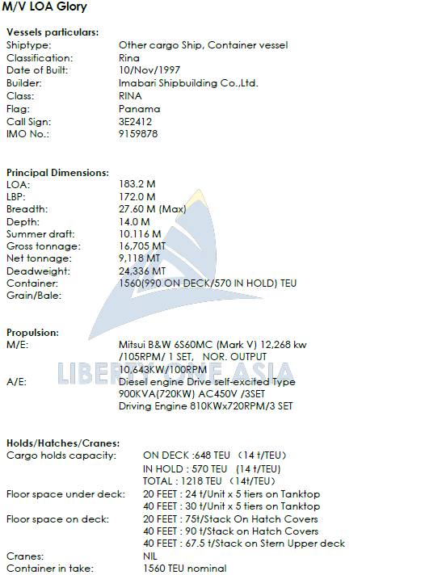
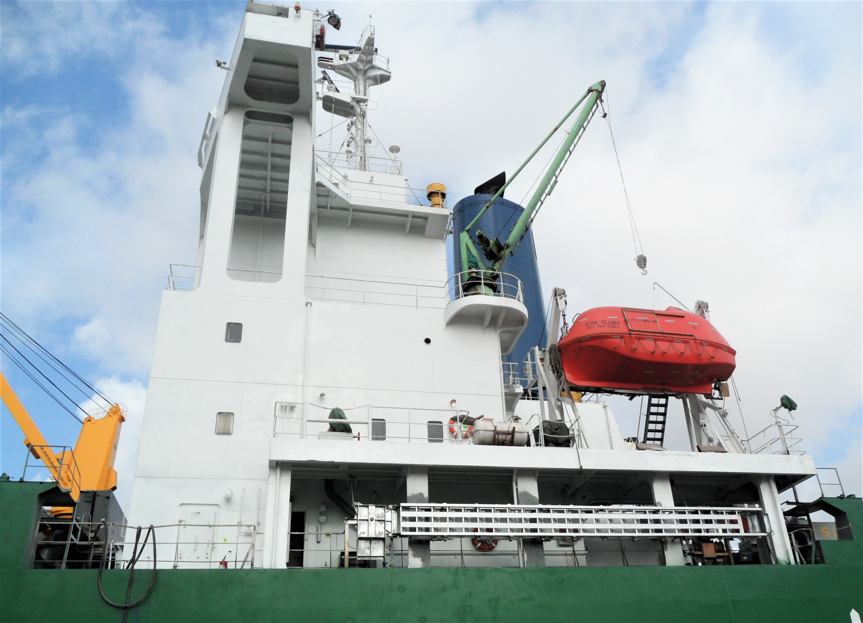
Liberty One Asia Fleet - Container

Slide 14
Contact
Bremen
Leer
Shanghai
Liberty Pier GmbH
Domshof 22
28195 Bremen
Phone +49 421 408 940-0
chartering@liberty-pier.com
www.liberty-pier.com
Liberty One Shipmanagement Liberty One (Asia) Pte. Ltd.
GmbH & Co. KG
Domshof 22 500 Yunjin Road
28195 Bremen Xuhui District Shanghai
Phone +49 421 178 795-0
info@liberty-one.biz
www.liberty-one.biz
Capital Liberty Invest (C L I)
Domshof 22
28195 Bremen
Phone +49 421 408 940-0
dietrich.schulz@liberty-one.biz
www.liberty-one.biz
Liberty One (Asia) Co., Ltd.
Room 2315&2316, Building A
Greenland Meeting Center
No 500, Yunjin Road, Xuhui District
Shanghai, P.R. China, 200232
Tel & Fax: +86 21 6422 1552
Email: mail@liberty-aisa.biz

